Slide 1

Predicting Employees Attrition
Shereef Bankole

Slide 2
Background Statement
Attrition is a common problem in all businesses
HR and top executive are very much concerned about keeping their employees
It is highly imperative to unravel the factors that leads to employees’ turnover and put in place a cost effect retentive plan
Here predictive model was performed and evaluated on employee attrition using openly available IBM HR Data

Slide 3
Procedures
Data loading
Data inspection and cleaning
Brief statistical analysis
Exploration data analysis –generating several plots
Data pre-processing-
Checking for sample imbalance
Employing SMOTE and ADASYN
Turning categorical variables to numeric variables
Model Development and Selection
Model Evaluation

Slide 4
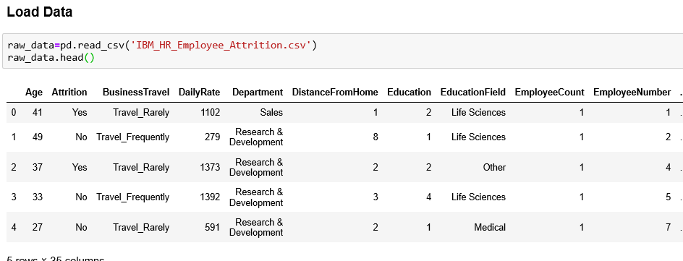
Data loading

Slide 5
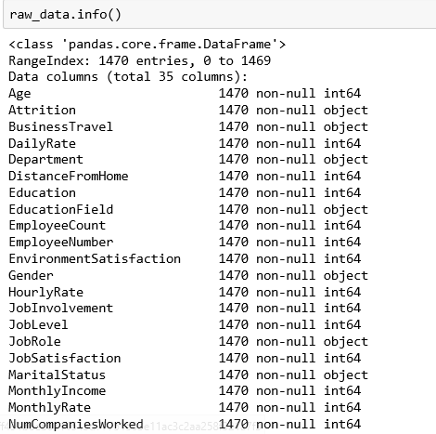
Data inspection and cleaning

Slide 6
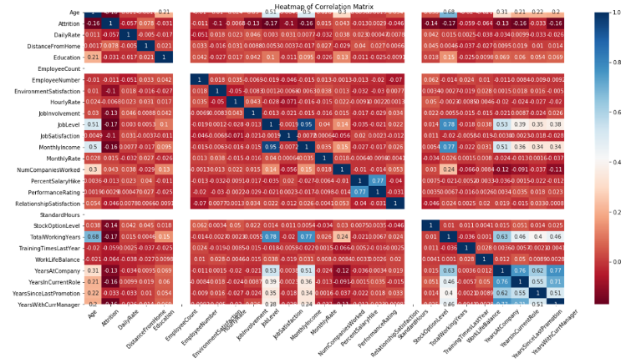
Brief statistical analysis

Slide 7
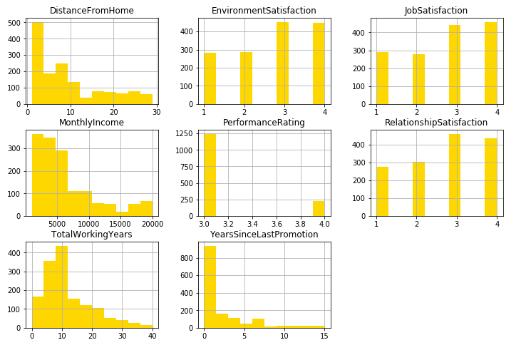
Exploration data analysis
EDA is key to performing modelling.
More than half of the employees live 10 miles away from the office
Two groups are identified based on environment satisfaction
Job satisfaction and relationship follow similar trend as environment satisfaction.
More than half of the employees earn less than $10000 monthly
All the employee received good performance rating
More than half have worked in the company for less than 10 years
Many were promoted within the last two years

Slide 8
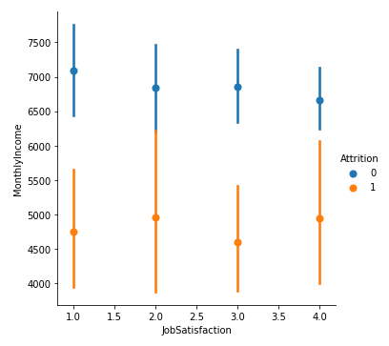
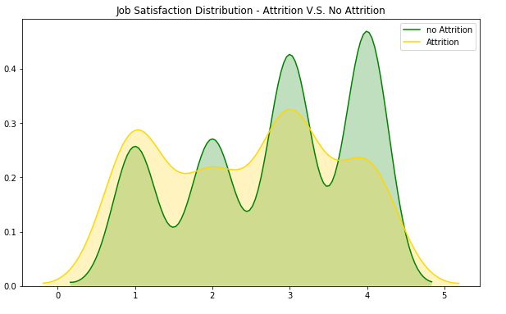
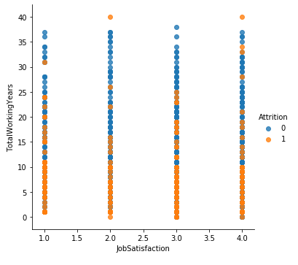
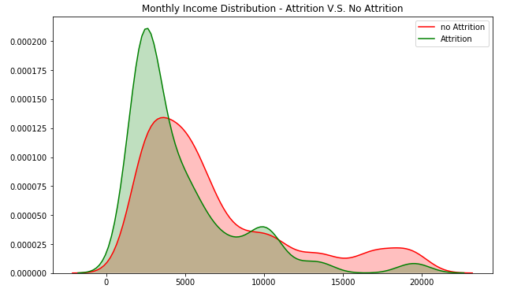
Exploration data analysis
Employees attrition is not related to job satisfaction.
Employee who have worked in the company for less than15 years are more likely to leave.
Lower income earners are more susceptible to attrition

Slide 9
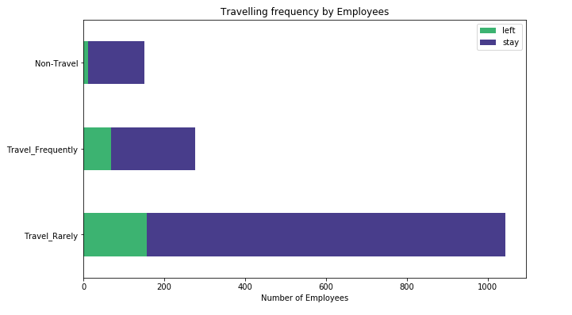
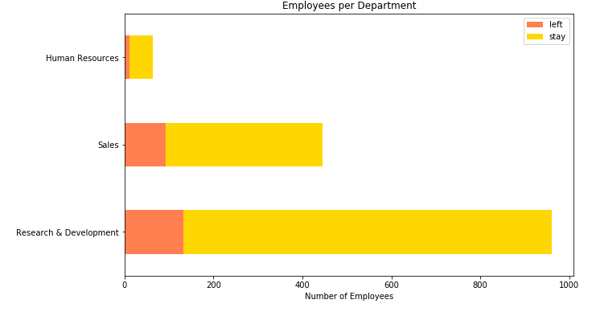
Exploration data analysis
Employee attrition by travelling and department

Slide 10
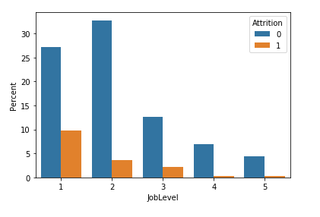
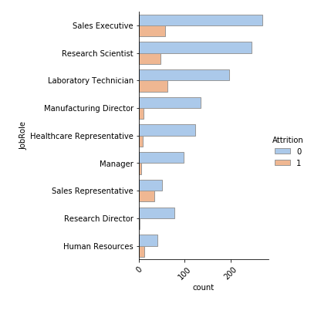
Exploration data analysis
Employee attrition by job level and job role
Employee in more junior role are more prone to leave for another company

Slide 11
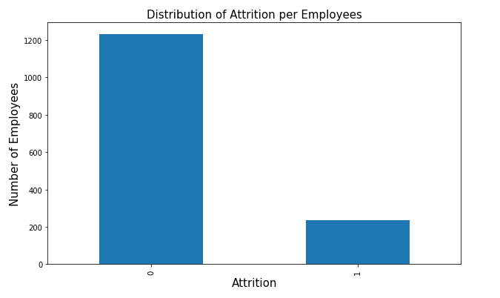
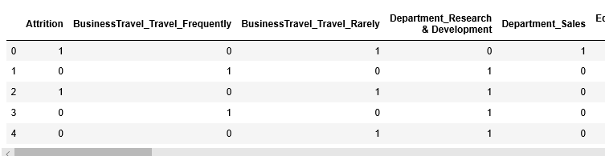
Data Pre-processing
Left: checking for data imbalance
Right: turning categorical variables to numeric variables.

Slide 12

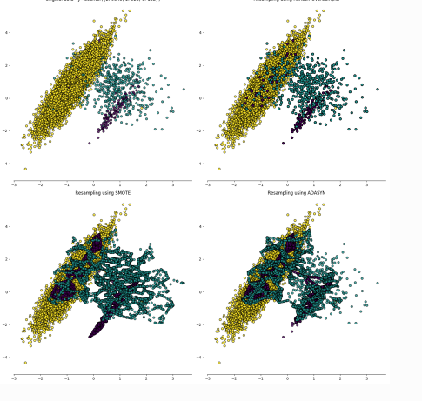

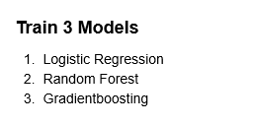
Model selection and development
SMOTE method of adjusting data imbalance performed better than ADASYN with logistic model.
Adjusted data with SMOTE were trained further with other models
SMOTE (Synthetic Minority Over-Sampling Technique) ADASYN (Adaptive Synthetic Sampling method)

Slide 13
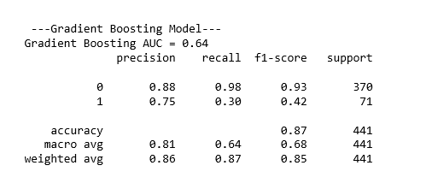
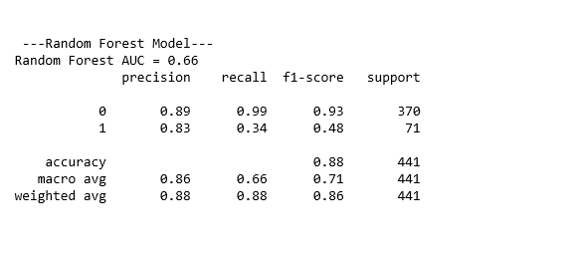
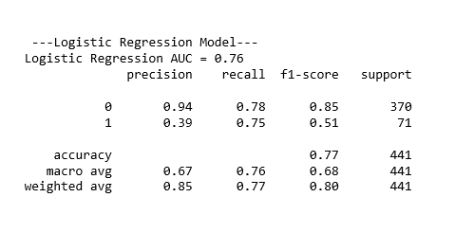
Model Evaluation
Top left table: Gradient boosting evaluation metrics
Top left table: Random Forest metrics
Bottom left: Logistic regression

Slide 14
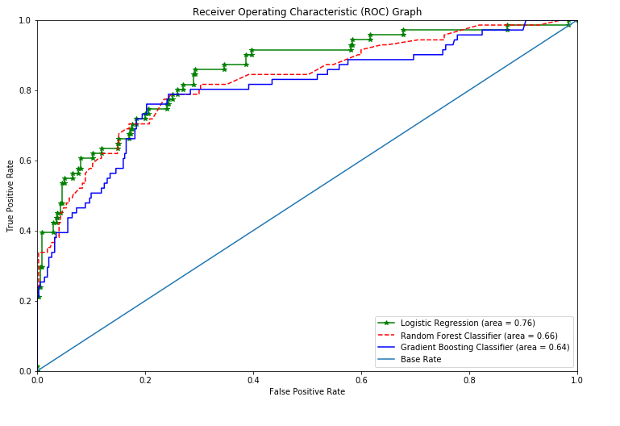
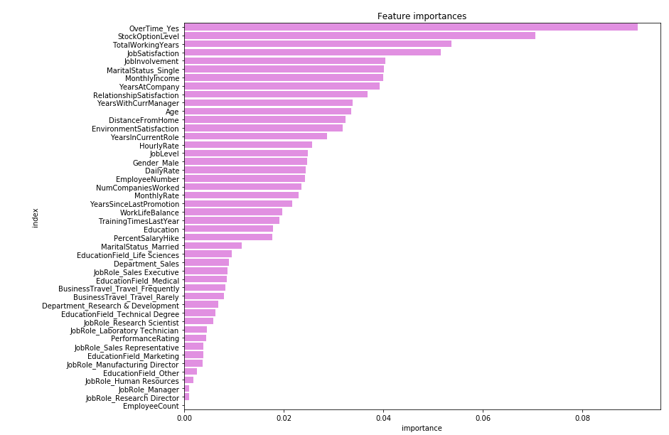
Model Evaluation
Top table: ROC for the 3 models
Bottom table: features importances

